Slide 1

Effect of PlayStation Purchases on my Daily Physical Activity
Sarp Efe AYDIN - 32541

Slide 2


My Dataset
My purchase history from PlayStation Network
Daily Steps Taken from Apple Health

Slide 3
My Hypothesis
Whenever I acquired new content to play with on my PS4 it would affect my steps taken and decrease it for 4 days after the purchase.

Slide 4
My Data from PSN
I requested the data from Sony via account settings. After some cleaning up, these data only consist of "Transaction Date" and "Content Type". Transaction dates are the dates that those "contents" ("New Game", "In-game Content", "Subscriptions" and "Apps") were acquired either for free or with money.

Slide 5
My Data from Apple Health
I downloaded the data from Apple Health directly. The data consist of "Date" and "Step Counts".

Slide 6
The data starts consist of the dates between 06-12-2017 and 08-29-2023.
There is also a period starting from 14-02-2022 to 18-06-2022 which did not have any data from PSN and Health data all had 0 values , so they were excluded.

Slide 7
I used Python libraries pandas, matplotlib and seaborn to calculate the average steps taken overall and for a window of 4 days after a day of any purchase and visualize the differences between those averages. To get rid of the unnecessary and extra date points I merged the purchases on the same days.

Slide 8
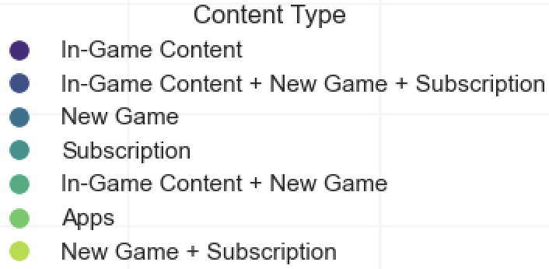
There were some days when I made multiple types of purchases. So I grouped them as shown above.

Slide 9
There are 77 different days with any type of purchase.
Overall average steps taken is 4520.45, overall post-purchase steps taken is 4149.75.

Slide 10
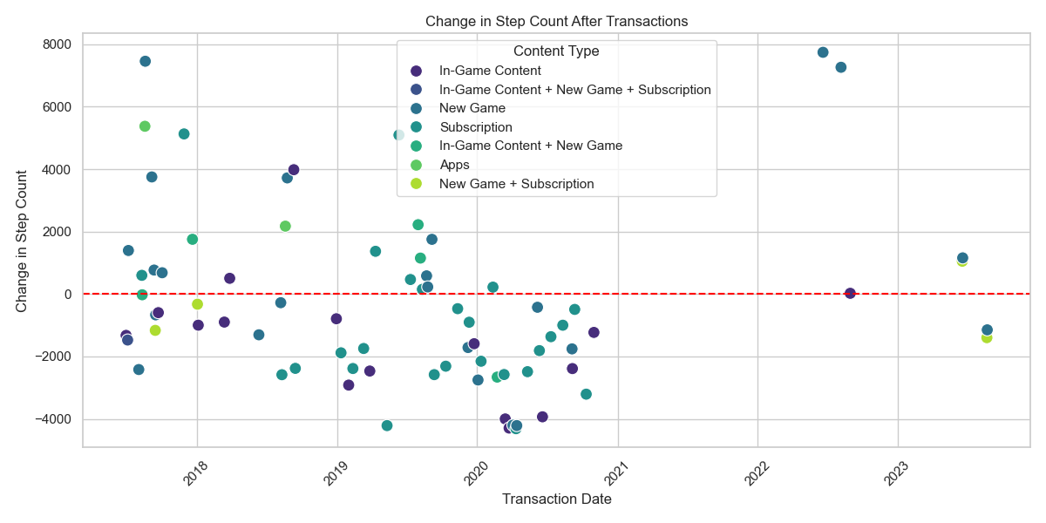
A scatter plot with axes of "Change in Step Count" and "Transaction Date" regarding the types of transactions

Slide 11
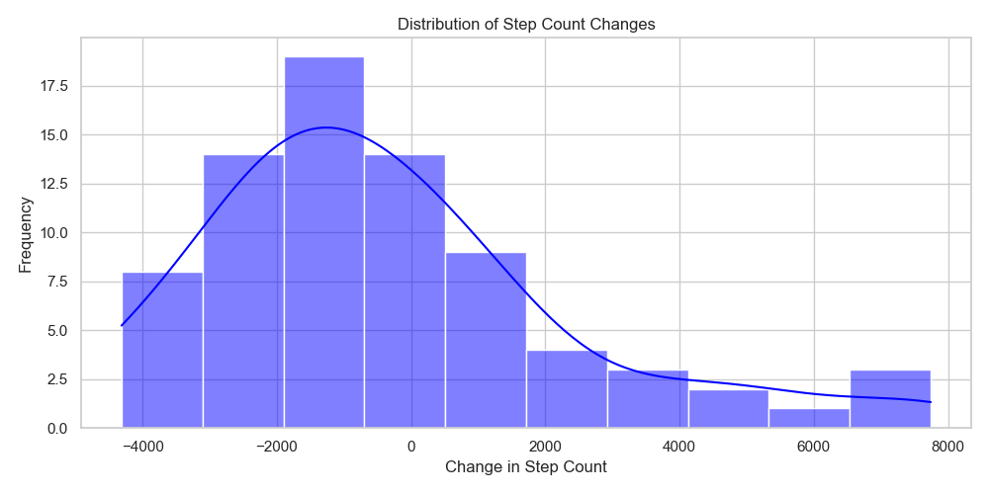
A histogram of distribution of step count changes with axes of "Frequency" and "Change in Step Count"

Slide 12
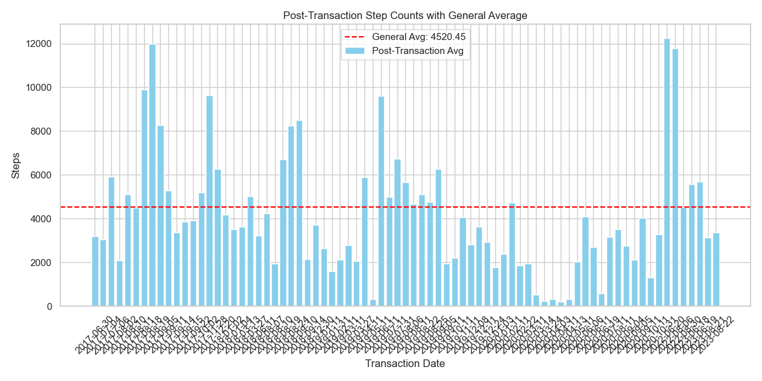
A bar plot with axes of "Steps" and "Transaction Date", showing the overall average steps taken and post-transaction average of 4 days after the transaction

Slide 13
After the plotting and visualization, I applied t-test and calculated the p-value using scipy library to see if I am able to reject the null hypothesis, which states that acquiring new content for PS4 has no effect on daily steps taken.

Slide 14
Results
Since the p-value acquired through t-test is greater than 0.05, we have insufficient evidence to reject the null hypothesis.
This tells us that acquiring new content for PS4 does not have a significant effect on the steps that I take.

Slide 15
Thank you

